Slide 1




Dekanex, LLC
Conversational PDF Chatbot with Text-to-Speech
AI-Powered Accessibility for Visually Impaired Users
Presented By
Yusra - CTAI-010
Muhammad Umer - CTAI-035
Messum Hassan - CTAI-043
Yousuf Navaid - CTAI-034
Syed Muhammad Ahsan - CTAI-025
Get Started

Slide 2


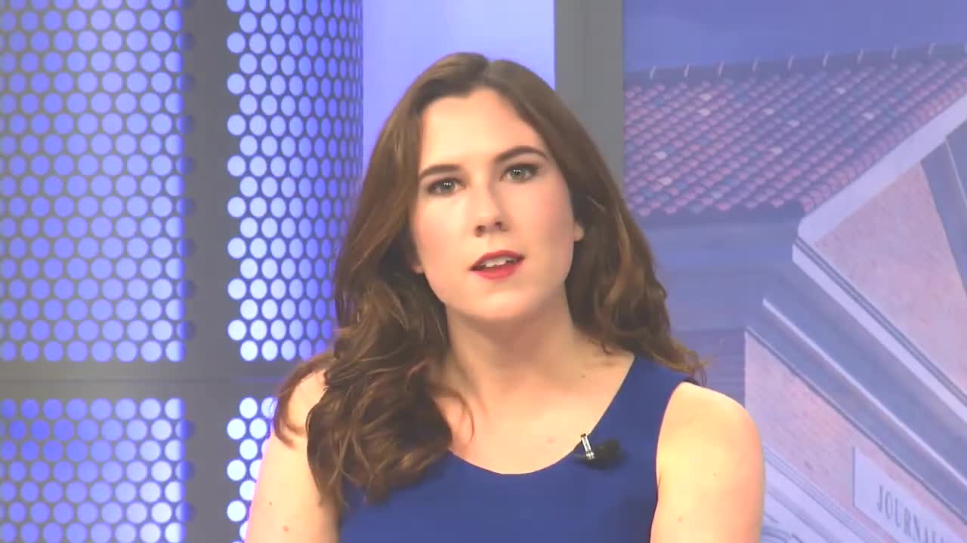

Challenges Faced by Visually Impaired Users

Slide 3

Problem
Challenges Faced by Visually Impaired Users
Global Accessibility Issues
Approximately 285 million people are visually impaired worldwide, many of whom struggle with accessing printed or digital materials.
Despite the growth of technology, existing solutions are costly and often fail to provide adequate interaction, especially for educational purposes.
Challenges in Education & Work
Inefficiencies in Existing Tools
Students and professionals with visual impairments struggle to engage with long-form content such as textbooks, research papers, or articles.
Limited access to essential documents and research materials leads to educational and professional challenges.
Many screen readers provide basic navigation but lack context-based interaction and can't fully help with understanding the content of complex documents.
Text-to-Speech (TTS) tools are often monotonous or insufficient for delivering context, making comprehension difficult.

Slide 4
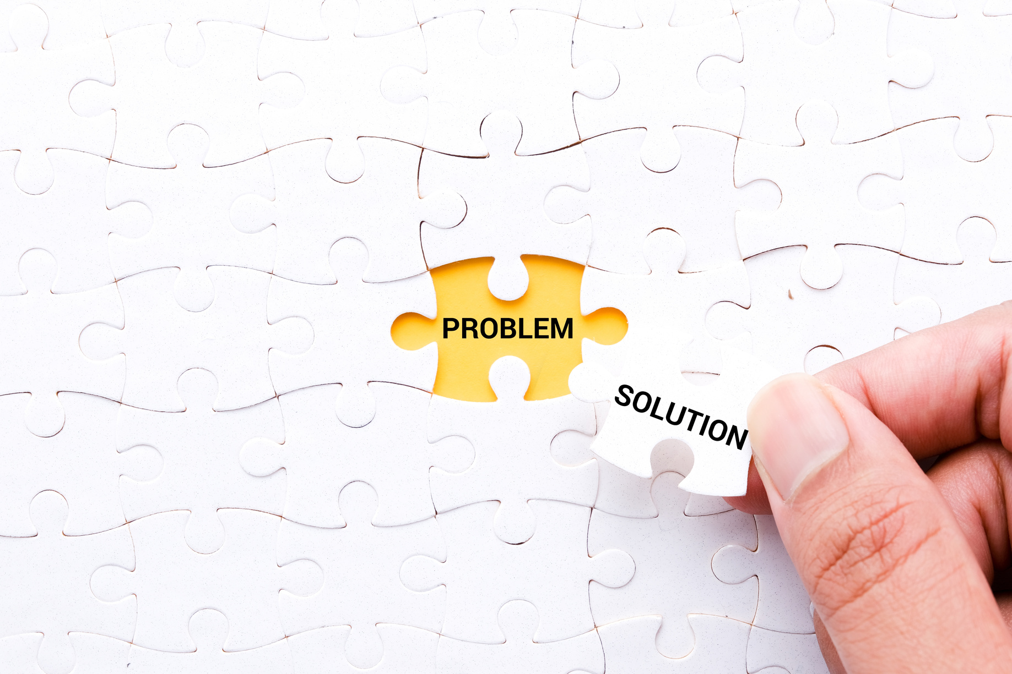
Understanding the Need
Why a New Solution is Essential
Lack of Advanced Accessibility Tools:
Popular tools like NVDA and JAWS (screen readers) are expensive or challenging to use, particularly for advanced needs.
The Knowledge Gap:
Only 10% of written materials worldwide are converted into accessible formats, leaving visually impaired users with limited access to essential resources.
Example Scenario:
A visually impaired student relies on classmates to read PDF lecture notes, as tools like NVDA don’t provide context-aware summaries or allow natural language interaction.

Slide 5
What Current Tools Miss
The Gaps in Existing Solutions
While various tools exist to assist visually impaired users, most fall short in addressing their advanced needs. Screen readers and basic Text-to-Speech (TTS) tools provide minimal accessibility but fail to deliver the depth of interaction required for complex tasks. These limitations, combined with high costs and lack of context-awareness, create significant barriers for education, professional work, and everyday document interaction. Below are key shortcomings of current solutions and why a more intelligent, accessible approach is essential.
Screen Reader (Jaws)
Text-to-Speech ( Balabolka)
High Costs
Linear navigation with no ability to understand or retrieve specific answers.
Limited functionality for complex documents like research papers or legal texts.
Lack conversational capabilities and context awareness.
Provide flat, monotonous voices, which can be tiring for extended use.
Advanced tools like JAWS can cost up to $1,200, making them inaccessible for users in low-income regions

Slide 6

Our Solution
A Smart, Accessible AI Solution
Our solution allows users to interact with PDF documents using natural language queries, making it more intuitive and accessible for visually impaired users.
By combining Text-to-Speech (TTS) with context-aware answers, we aim to transform how visually impaired users access and engage with information.

Slide 7
Our Solution
A Smart, Accessible AI Solution
Our solution allows users to interact with PDF documents using natural language queries, making it more intuitive and accessible for visually impaired users.
Example: A visually impaired user asks, “Summarize Section 3 of this research paper.” The chatbot retrieves and delivers the summary.
By combining Text-to-Speech (TTS) with context-aware answers, we aim to transform how visually impaired users access and engage with information.
Example: A teacher uploads a syllabus and queries, “What are the objectives of this course?” The chatbot reads the answer aloud in a clear, engaging voice

Slide 8
RAG CHAIN
Artificial Intelligence is enabling a shift towards personalized medicine, where treatment plans are tailored to the individual needs of each patient. By analyzing genetic information, lifestyle factors, and medical history, AI can recommend customized treatments that are more effective and better suited to each person’s unique profile.
1
Tailored Treatment Plans
Predictive Analytics
Improved Effectiveness
AI enables the development of customized treatment plans based on individual patient data, including genetic information and lifestyle factors.
By utilizing predictive analytics, AI helps healthcare providers anticipate patient outcomes, allowing for timely and proactive interventions.
Personalized approaches enhance treatment effectiveness while minimizing potential side effects, leading to better patient experiences and outcomes.

Slide 9
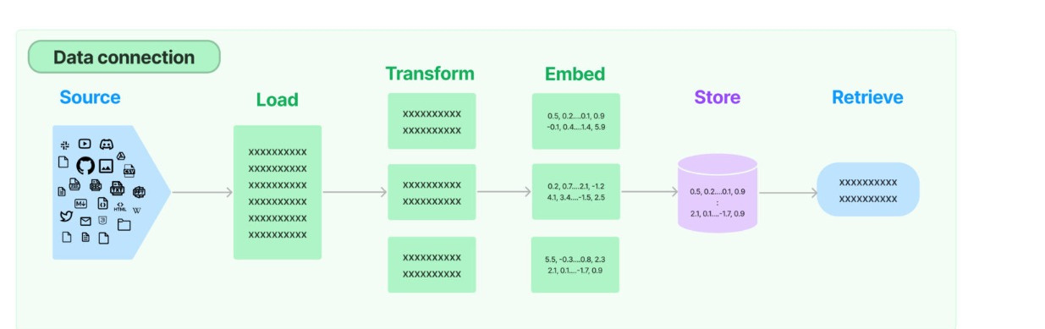
RAG CHAIN
Enhanced Precision

Slide 10

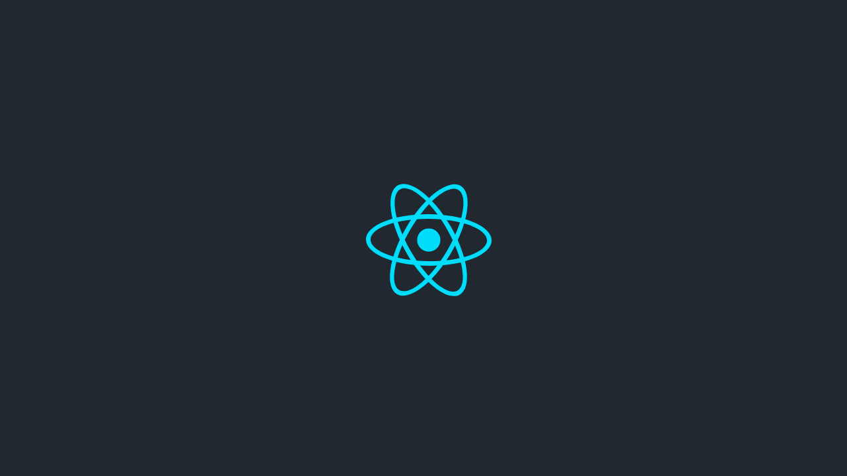

Front-End (React JS)
Used React JS for front-end to achieve the following
Clean User Interface
Easy Navigation
Accessibility Requirements
Easy Integration with Python

Slide 11

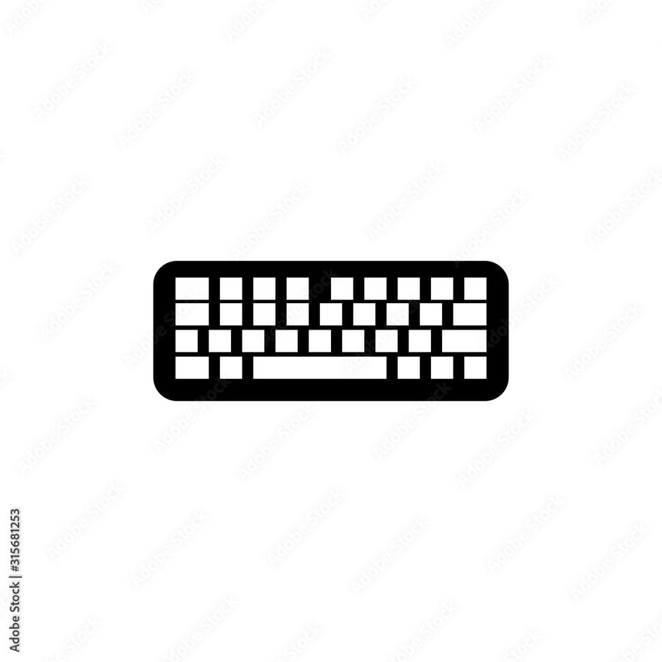
Keyboard Shortcuts
These keyboard shortcuts can be used for accessibility
Down Arrow Key => Select PDF File
Up Arrow Key => Upload Selected PDF
Right Arrow Key => Switch to Query Box
Enter => Submit Query

Slide 12
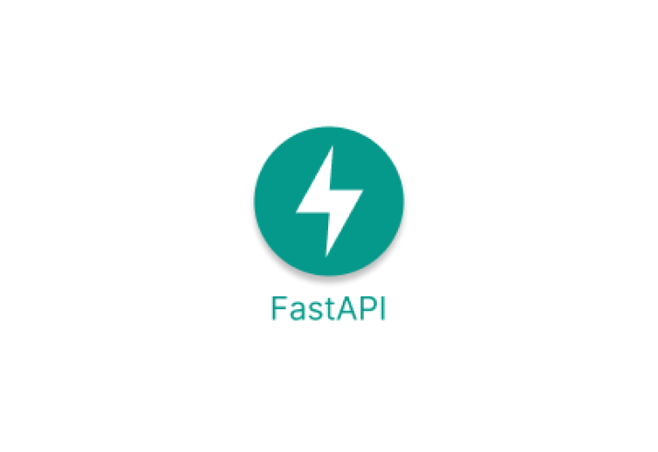
Back-End (FastAPI)
Used FastAPI for back-end to achieve the following
PDF Data Extraction
Response Generation
Text-to-speech
Session Management
Easy Integration with React

Slide 13
Packages Used
Following python libraries were used
FastAPI
PyPDF2
Langchain
Pydantic
gTTS

Slide 14
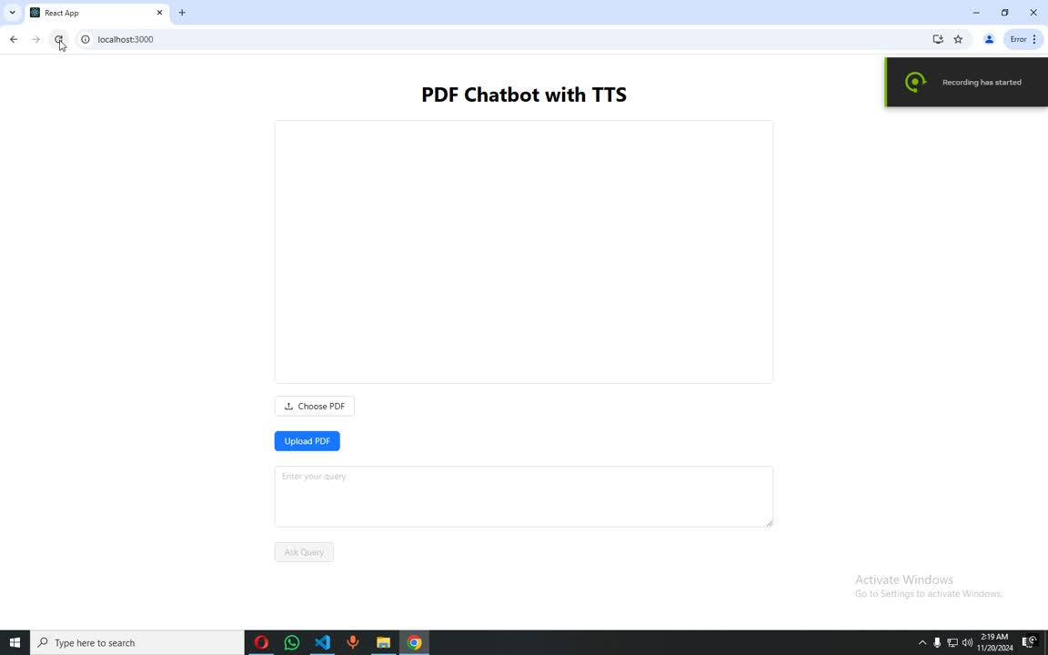
Interactive Demo

Slide 15
Thank You
For your attention! If you have any questions or would like to discuss further, please feel free to reach out.
Dekanex, LLC.

